Slide 1

MYSQL
PROJECT TOPIC:FOOD & HOSPITALITY Recipe & Ingredient Inventory

Slide 2
PROBLEM STATEMENT
In restaurants and hotels, keeping track of ingredients and recipes is very important. Sometimes, ingredients run out suddenly or too much is bought and wasted. This causes problems in cooking food on time and can lead to unhappy customers.
This project is about creating a MySQL database to manage recipes and ingredient inventory. It will store details like which ingredients are used in which recipes, how much stock is available, and when to reorder items. This system will help kitchen staff know what is available, avoid running out of ingredients, and make sure food is made properly every time.

Slide 3
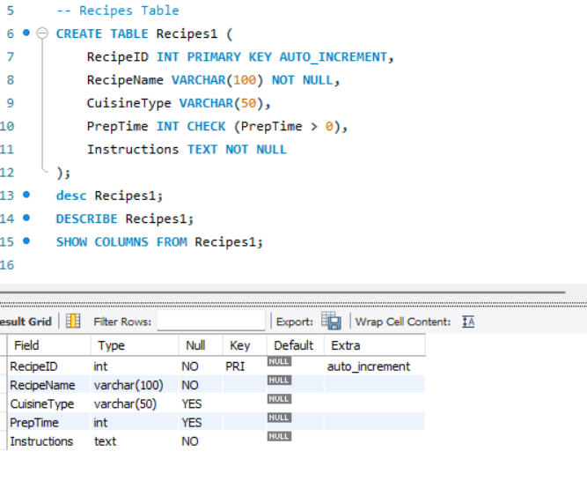
1.CREATING DATABASE & USING DATABASE
CREATE DATABASE FOODHOSPITALITY12;
USE FOODHOSPITALITY12;

Slide 4
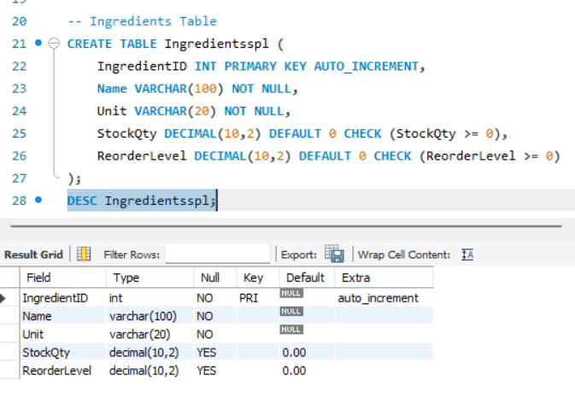
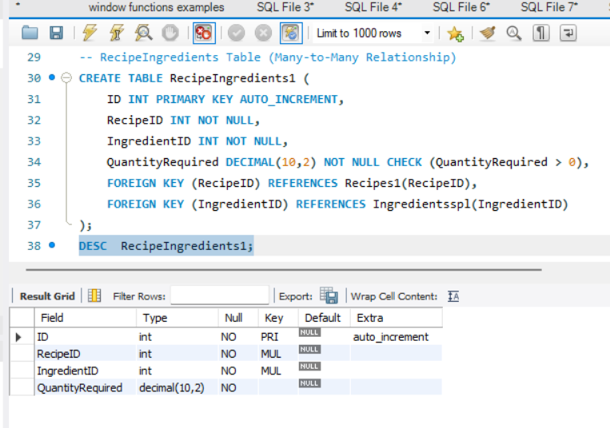
2.DESCRIBING TABLES

Slide 5
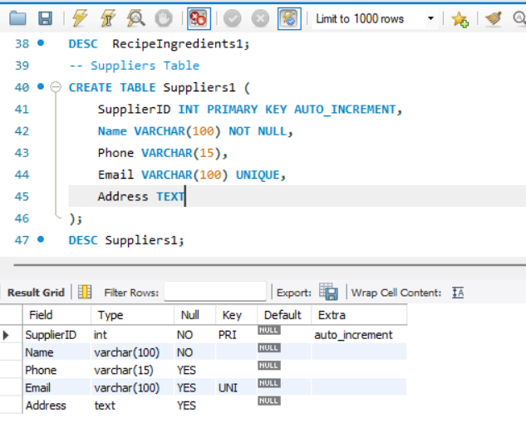
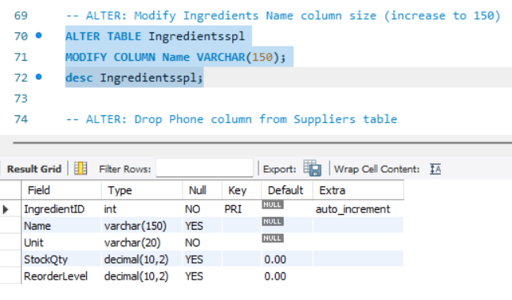
3. ALTER: Modify Ingredients Name column size (increase to 150)

Slide 6
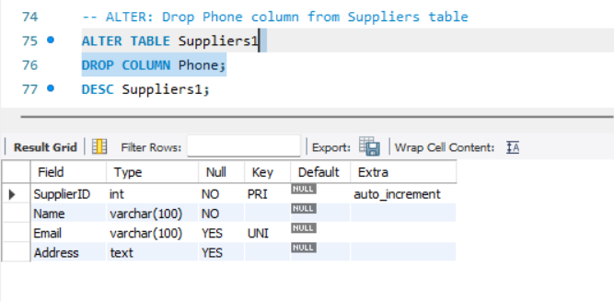
4.ALTER: Drop Phone column from Suppliers table

Slide 7
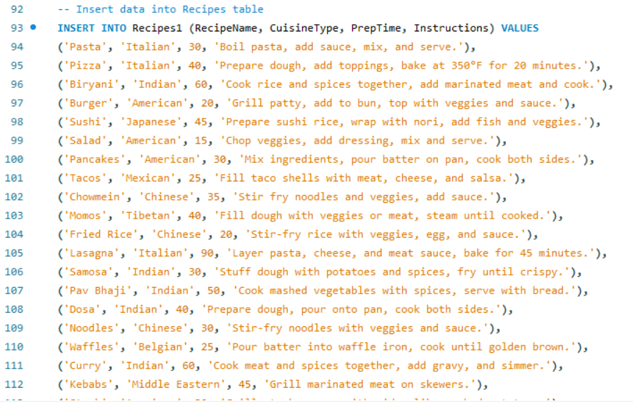
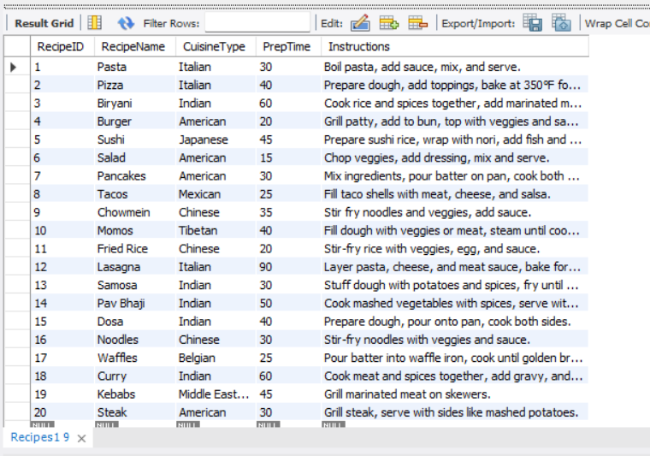
5.DATA INSERTION & MANIPULATION NOW INSERTING DATA INTO CREATED TABLES # SELECT * FROM Suppliers1;

Slide 8
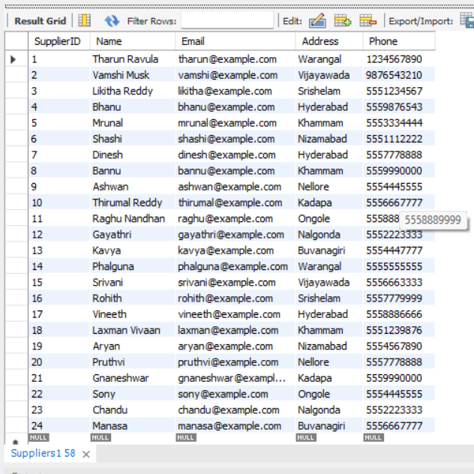
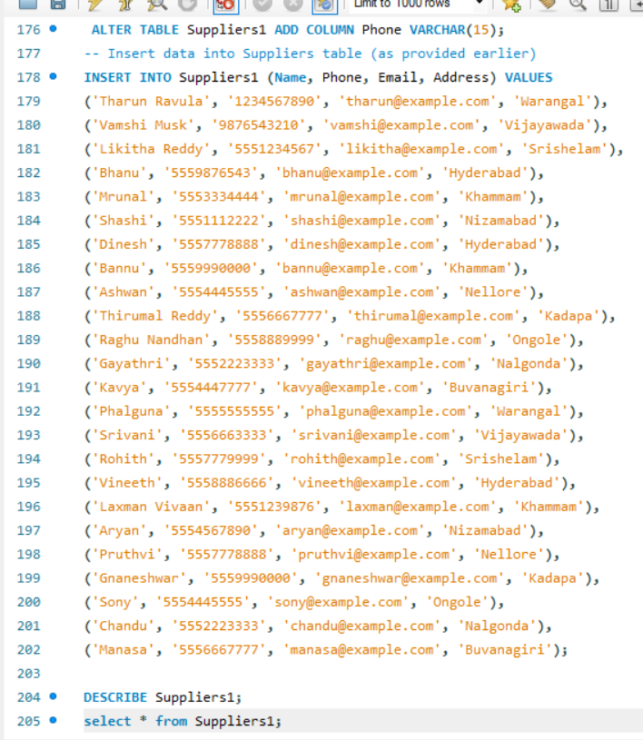
Suppliers1 table inserting data

Slide 9
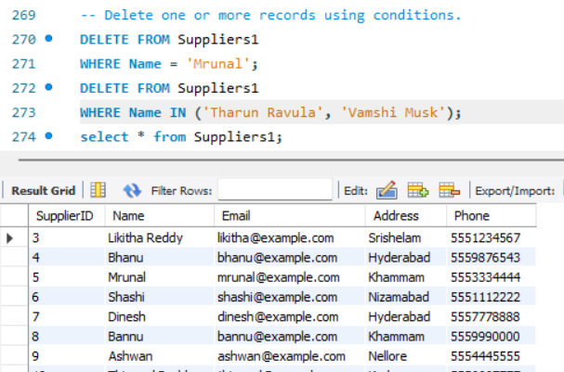
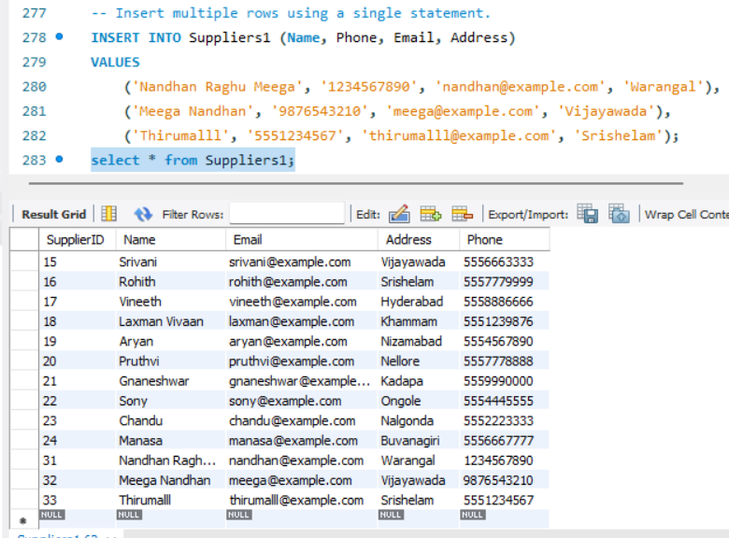
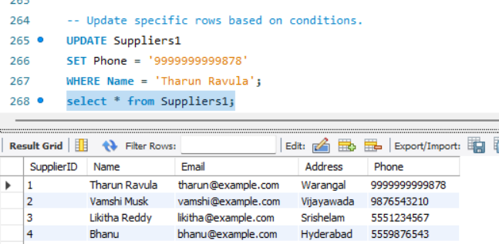
6.Update specific rows based on conditions.
7.Delete one or more records using conditions
8.Insert multiple rows using a single statement.

Slide 10
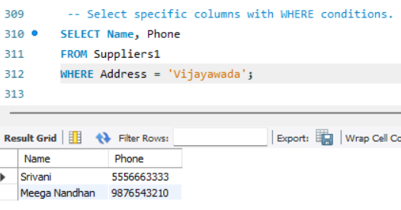
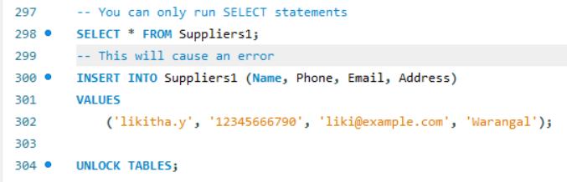
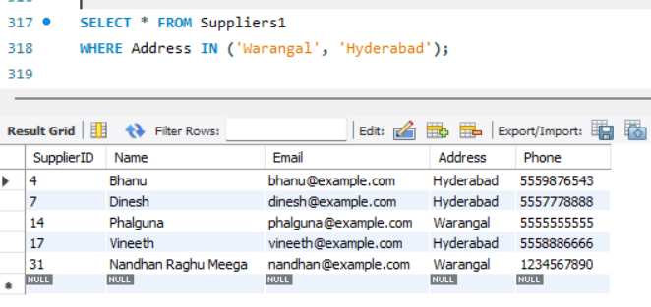
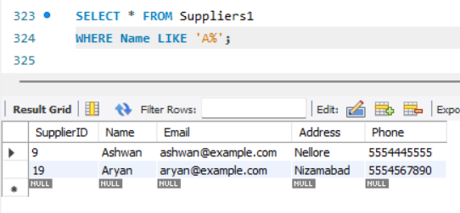
9.Select specific columns with WHERE conditions.
11.Lock & unlock
10.Use BETWEEN, IN, IS NULL, LIKE for filtering.
12.Like for filtering

Slide 11
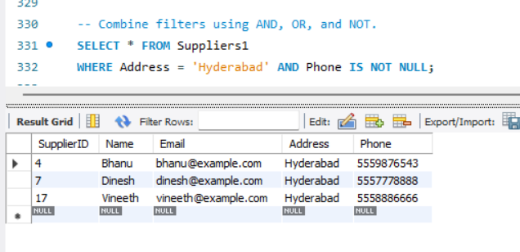
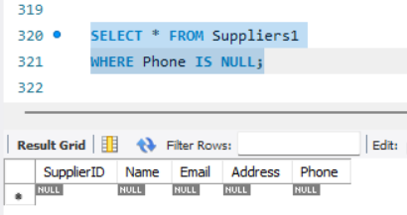
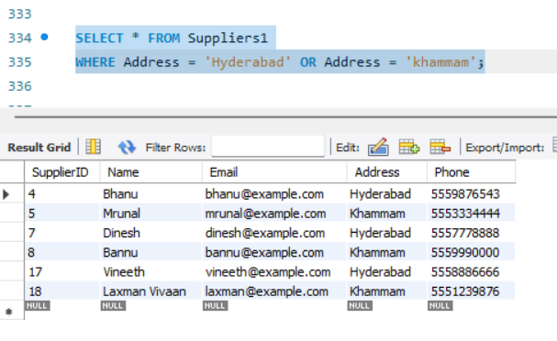
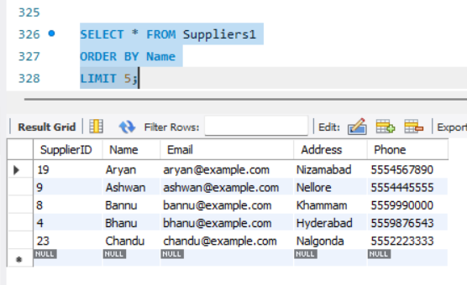
13.Combine filters using and,or,not.

Slide 12
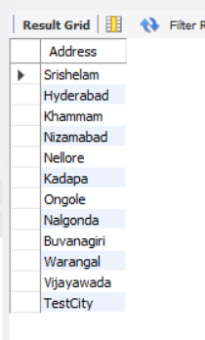
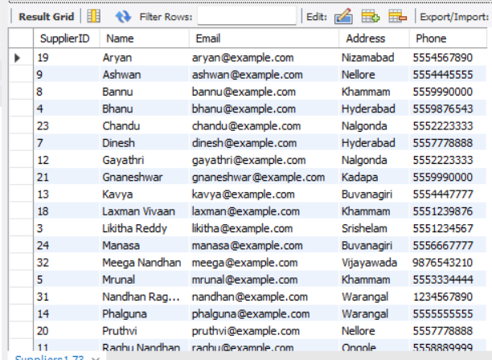
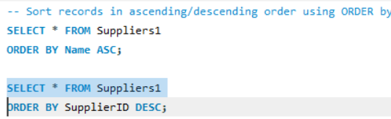
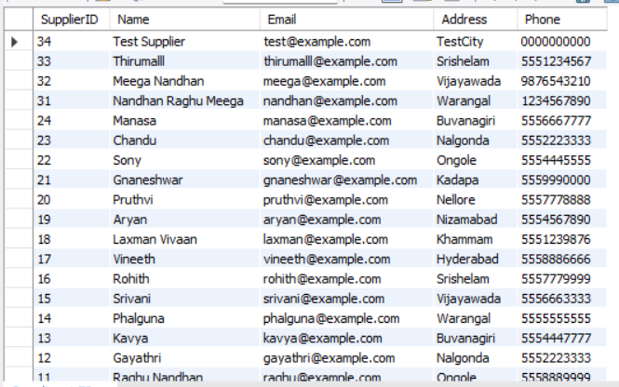
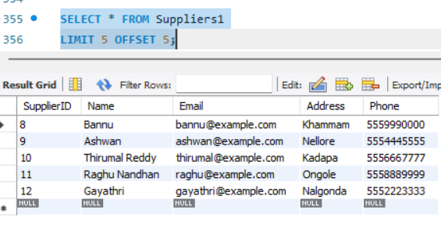
Sorting, Distinct, and Pagination
- 16) Display unique values from a column using DISTINCT.
SELECT DISTINCT AddressFROM Suppliers1;
-- 17) Sort records in ascending/descending order using ORDER BY.
-- 18) Implement pagination using LIMIT and OFFSET.

Slide 13
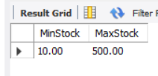
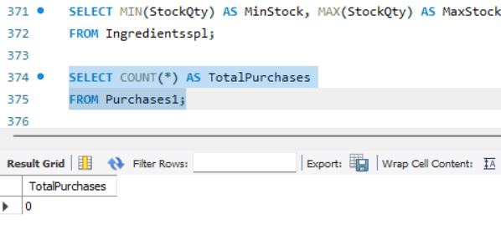
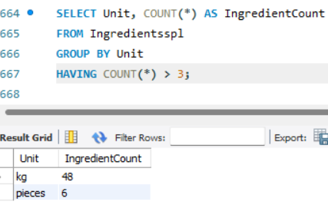
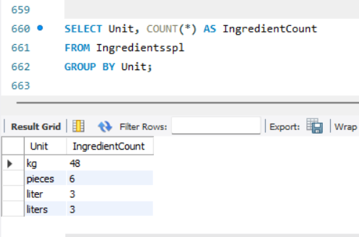
5. Aggregate Functions & Grouping
-- 19) Use COUNT, SUM, AVG, MIN, MAX on relevant numeric columns.
-- 21) Filter groups using HAVING (e.g., show groups with more than 3 items).
-- 20) Group records by a specific column and apply aggregation.

Slide 14
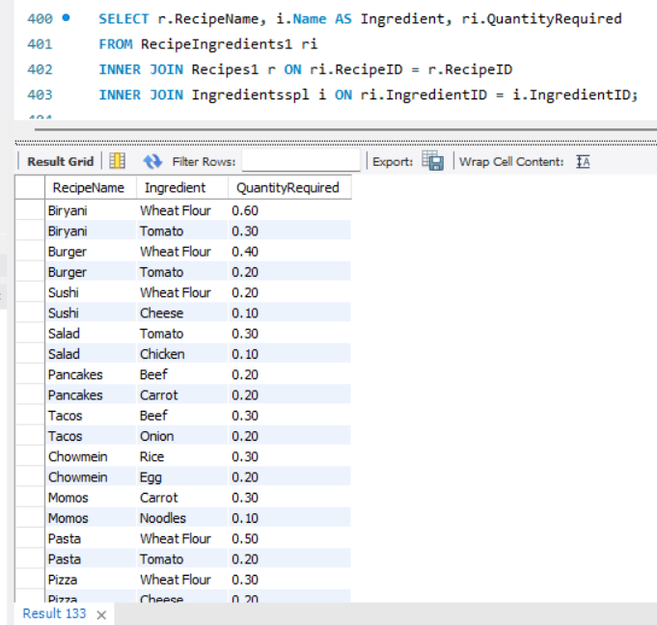
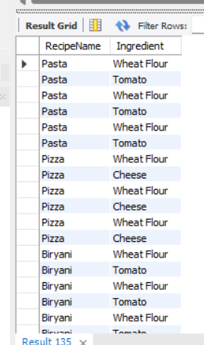
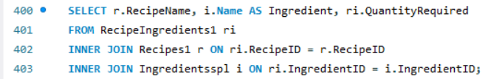
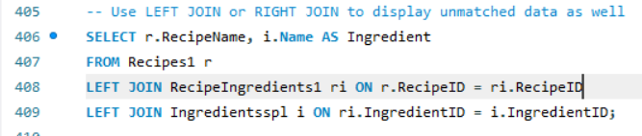
6. JOINS
-- 22) Use INNER JOIN to combine data from at least two related tables.
-- 23) Use LEFT JOIN or RIGHT JOIN to display unmatched data as well.

Slide 15
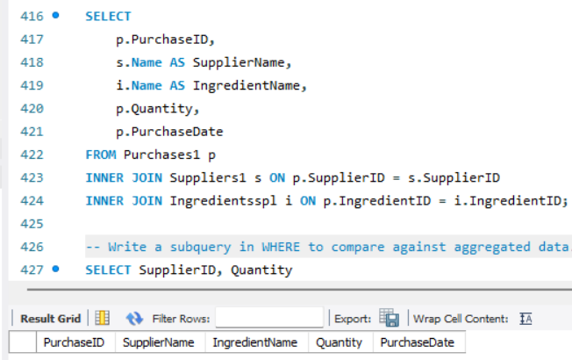
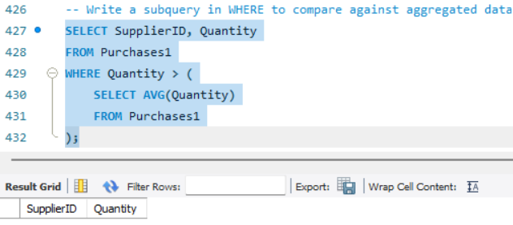
-- 24) Join three or more tables to produce a meaningful report.
-- 25) Write a subquery in WHERE to compare against aggregated data.

Slide 16
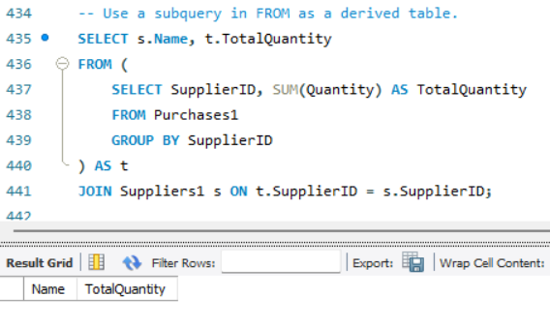
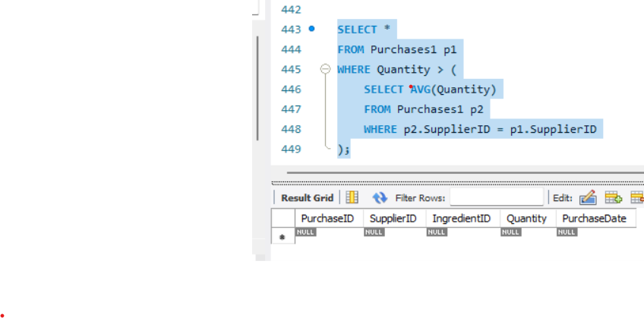
-- 26) Use a subquery in FROM as a derived table.
-- 27) Implement a correlated subquery for row-wise comparison.

Slide 17
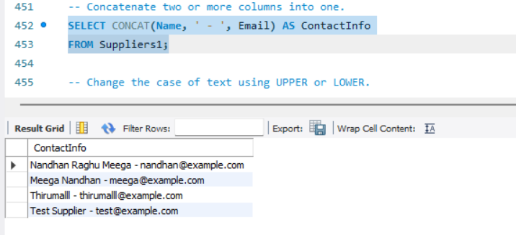
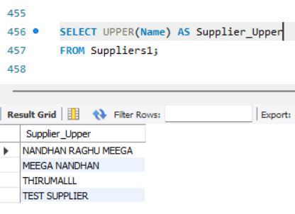
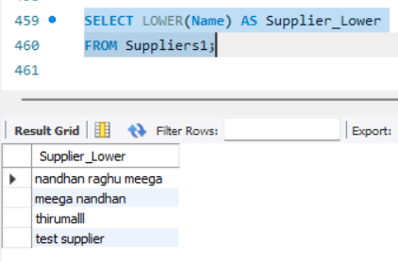
-- 28) Concatenate two or more columns into one.
-- 29) Change the case of text using UPPER or LOWER.

Slide 18
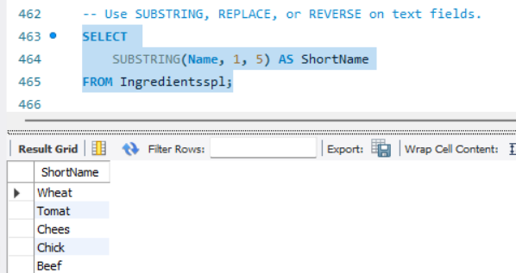
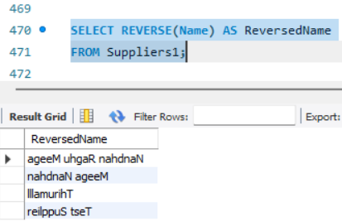
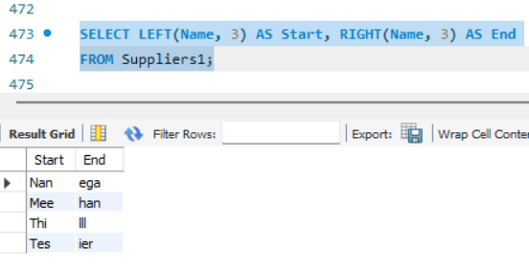
-- 30) Use SUBSTRING, REPLACE, or REVERSE on text fields.
Extract left/right parts of a string, Use Other Strings.

Slide 19
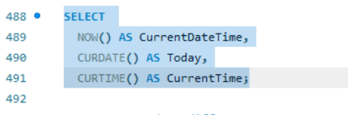
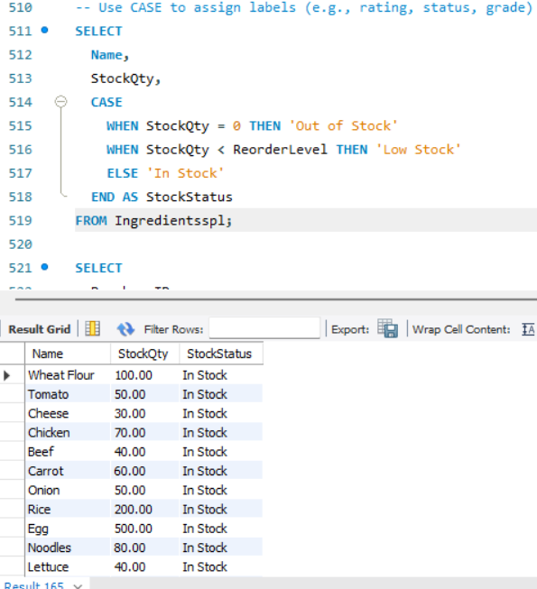
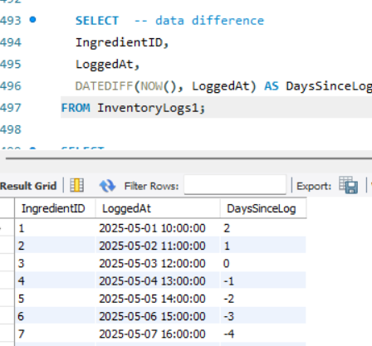
31.Get current date/time using NOW(), CURDATE(), CURTIME().
32.Use case assign labels
Date difference

Slide 20
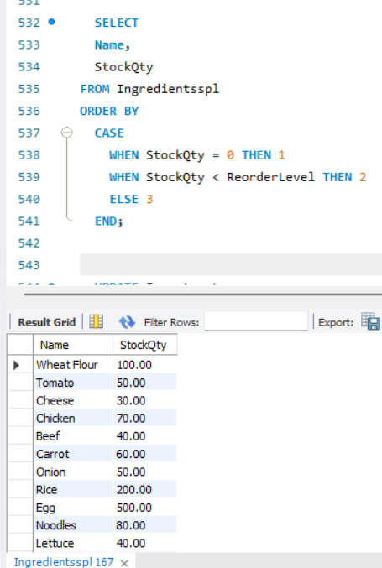
33.Use CASE in ORDER BY or UPDATE to apply dynamic logic.

Slide 21
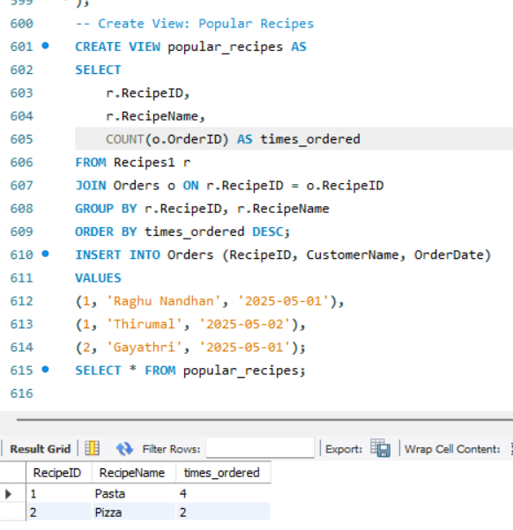
Views
Create a view that summarizes key data (e.g., top customers, popular products).

Slide 22
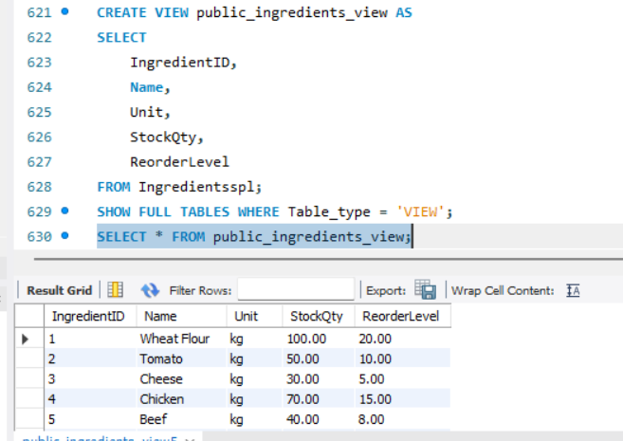
Create a view for public reporting (e.g., showing only non-sensitive data).

Slide 23

ER Diagram :Draw the ER diagram showing tables, primary keys, and relationships. .

Slide 24

THANK YOU!!
ANY QUESTIONS?

